Slide 1
META PROGRAMMING
By Mykhailo Torskyi

Slide 2
PROXY & REFLECT
Starting with ECMAScript 2015, JavaScript gains support for the Proxy and Reflect objects
They allow to intercept and define custom behavior for fundamental language operations, such as:
property lookup
Assignment
Enumeration
Function invocation

Slide 3
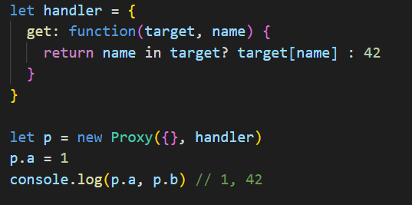
PROXY
Proxy objects allow you to intercept certain operations and to implement custom behaviors
target – is an object to wrap.

Slide 4
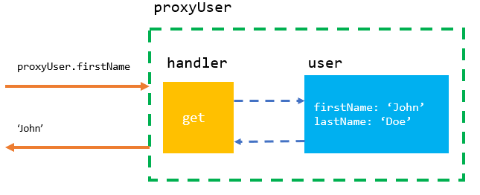

Slide 5
PROXY TRAPS
handler – is an object that contains methods to control the behaviors of the target. The methods inside the handler object are called traps
The get() trap is fired when a property of the target object is accessed via the proxy object
The set() trap controls behavior when a property of the target object is set(target, property, value)

Slide 6
MORE TRAPS
construct – traps usage of the new operator
getPrototypeOf – traps an internal call to [[GetPrototypeOf]]
setPrototypeOf – traps a call to Object.setPrototypeOf
isExtensible – traps a call to Object.isExtensible
preventExtensions – traps a call to Object.preventExtensions
getOwnPropertyDescriptor – traps a call to Object.getOwnPropertyDescriptor

Slide 7
REFLECT
Reflect is a built-in object that provides methods for interceptable JavaScript operations. The methods are the same as those of proxy handlers. Reflect is not a function object, so it's not constructible.

Slide 8
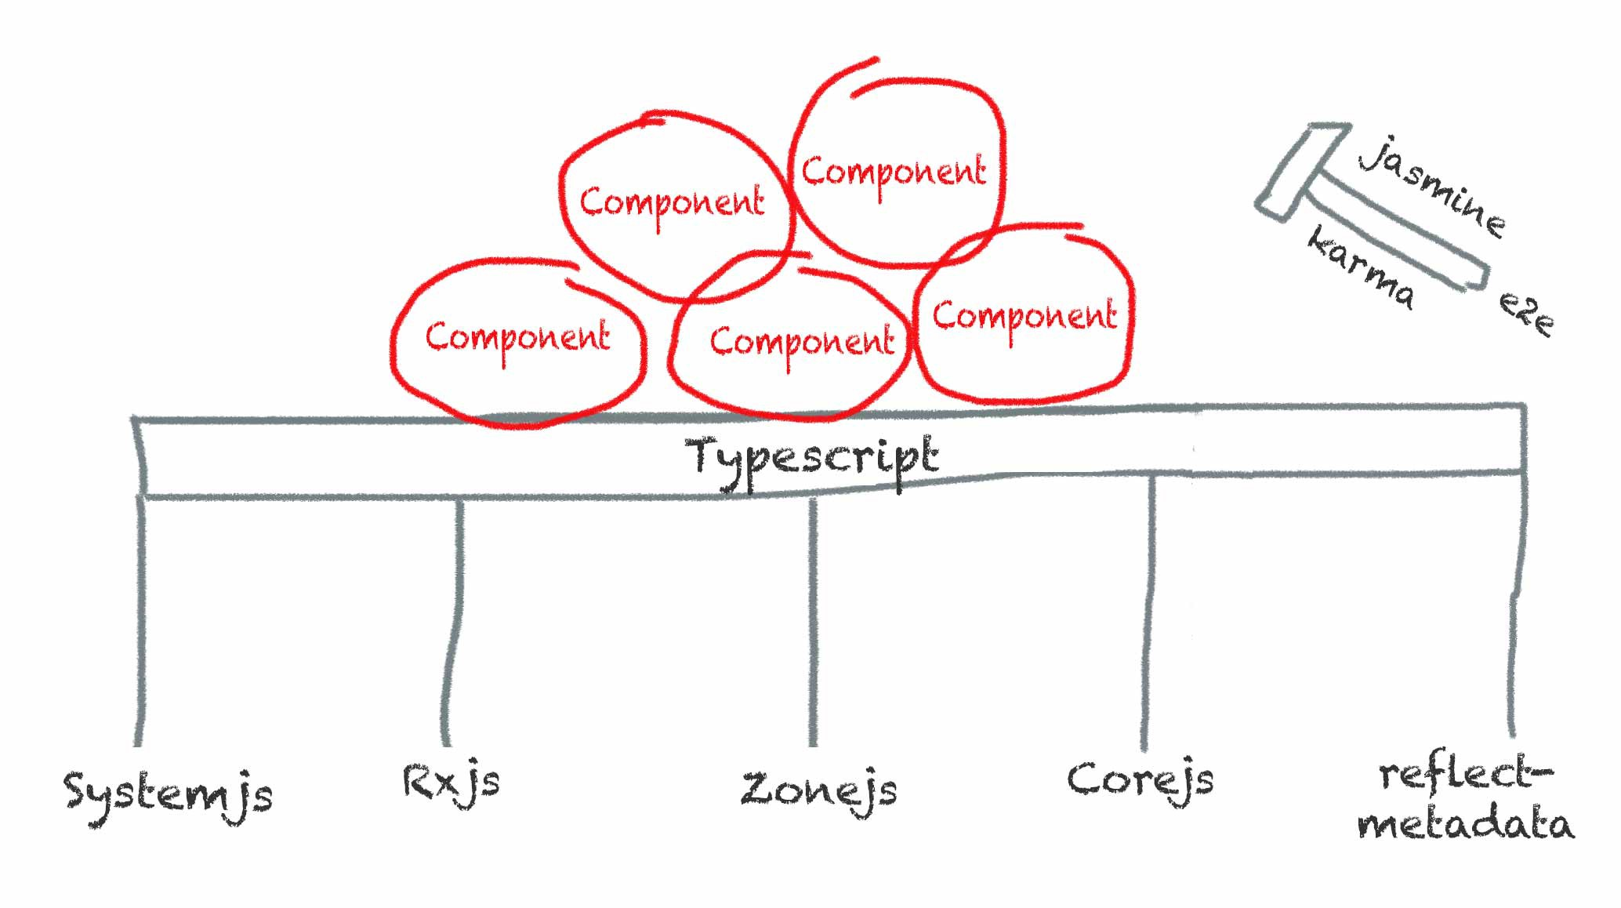

Slide 9
REFLECT METHODS
Reflect.apply(target, thisArgument, argumentsList) - Calls a target function with arguments as specified by the argumentsList parameter
Reflect.get(target, propertyKey[, receiver]) - Returns the value of the property. Works like getting a property from an object as function
Reflect.has(target, propertyKey) Returns a Boolean indicating whether the target has the property. Either as own or inherited. Works like the in operator as a function

Slide 10
SYMBOL
The Symbol() function returns a value of type symbol, has static properties that expose several members of built-in objects
A symbol value may be used as an identifier for object properties; this is the data type's primary purpose, although other use-cases exist, such as enabling opaque data types, or serving as an implementation-supported unique identifier in general

Slide 11
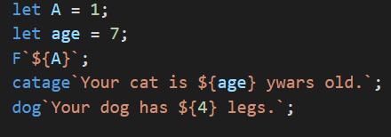
TAGGED LITERALS
It’s possible to combine template literals with a custom-written function created specifically to work in the context of a string literal. Hence, this is where the concept of tagged template literal concept comes from
The “tag” is the function name

Slide 12

Whatever the tagged function returns will be the replacement of the actual template literal provided.

Slide 13


